Slide 1
Deep Learning Neural Network

Slide 2
Neural Network.
Hidden
Input
Output
It has Interconnected input and output In which each connection has an associated weights
It will adjust the weight during the learning process
Input
Perceptron.
Output
Only Input and output Layer no hidden layer
Simple decision making

Slide 3
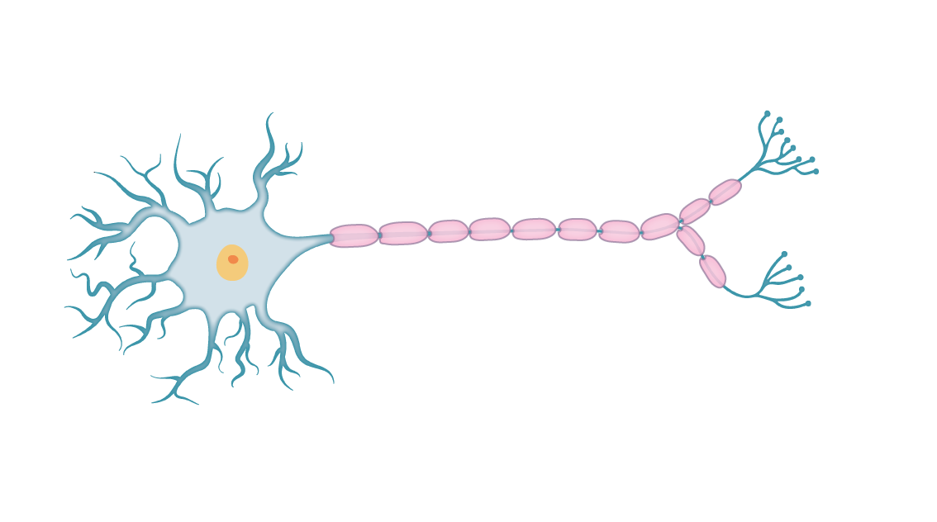
Neuron & Activation Function.
Cell Body
Neuron
Dendrites
Synapse
Axon
Like a Human Brain, here a Neuron takes input and do some function to give the output
Function going to be the Mathematical function
Those Function is known as ACTIVATION function
Activation Function
Step Function
Sigmoid Function
Tanh Function
ReLU Function
Neuron
Inputs
OUTPUT
Activation Fn.

Slide 4
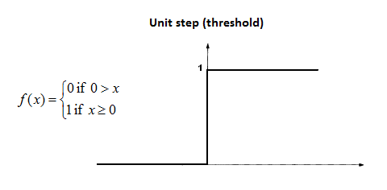
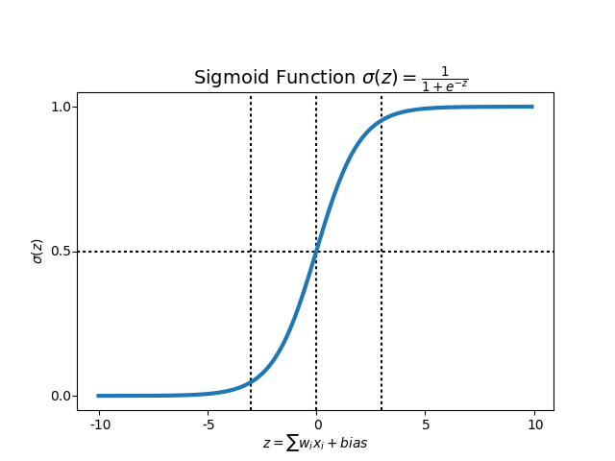
Activation Function.
STEP Function
If value of X is greater than or equal to 0, then output is 1, If value of X is less than 0, then output is 0
Since step Function is non differentiable to zero, it can’t do the gradient descent method, so it can’t update weights.
SIGMOID Function
If value of X is infinity, then output is 1, If value of X is negative infinity, then output is 0
It captures non-linearity in the data
It can use Gradient descent & Back propagation method to calculate weights.
Output range [0,1]

Slide 5
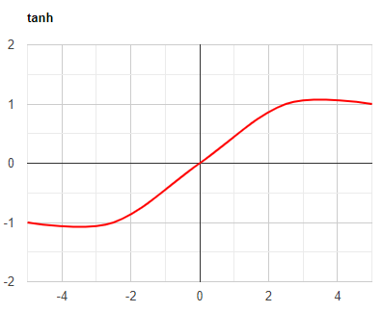
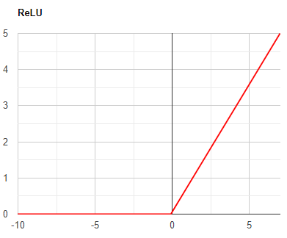
Activation Function.
Tanh Function
Rescaled of Sigmoid Function
Output range [-1,1]
Better learning rate requires, higher gradient. In some times, for the data is centred around 0, derivatives are higher.
ReLU Function
Rectified Linear Unit. if any negative input is detected, it returns 0, otherwise it returns the value back.
Leaky ReLU Function
Same as ReLU, like returning same for Positive. But for negative values instead of returning zero, it has constant slope

Slide 6
Deep Learning Algorithm.
01
ARTIFICIAL NEURAL NETWORK (ANN)
02
RECURRENT NEURAL NETWORK (RNN)
01
CONVOLUTIONAL NEURAL NETWORK (CNN)
www.pantechsolutions.net

Slide 7
ANN
Hidden
Input
Learns any Non-Linear Function, It is known as Universal Function Approximators
Activation Function introduce non linear property to network, so it will identify complex relationship between input & output
Output of each neuron is the activation of weighted sum of Input, If there is no Activation function, network can't learn non-linear function
Feed Forward Neural Network – Input processed in one direction
When hidden layer is more than one, that is Deep Neural Network
Output

Slide 8
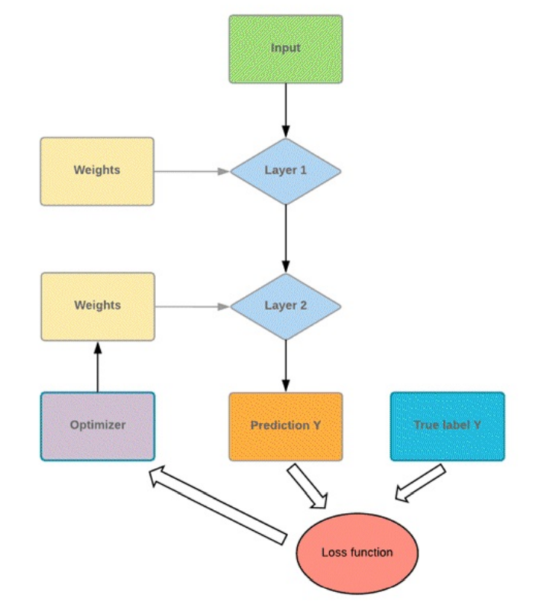
Flow chart
The program takes some input values and pushes them into two fully connected layers.
The network uses the optimizer, updates its knowledge, and tests its new knowledge to check how much it still needs to learn
The program will repeat this step until it makes the lowest error possible
The network has to be better optimized to improve the knowledge

Slide 9
RNN
Hidden
Input
Looping system in hidden layer of ANN is known as RNN
It captures sequential info of input data, that is dependency between words to make prediction. Whereas, ANN cannot capture sequential information
RNN shares parameters across different time steps, so that there will be few parameter to train
It is the time series version of ANN. Common Recurrent layers are LSTM(Long Short Term Memory)
It is mostly used in NLP (Natural Language Processing)
Output

Slide 10
CNN
CNN learns the filter automatically to extract the right features from the data
It captures spatial features (Arrangement of pixels) whereas ANN can’t.
It also follows parameter sharing like RNN, applies single filter in different part of single image. Whereas ANN can’t.
It don’t have recurrent connections like RNN, instead it has convolution type of hidden layers
Convolution and pooling functions are used as activation functions
CONVOLUTION: Input image and other as Filter on input image(Kernel) produces output image.
POOLING: picking maximum value from selected region is Max pooling and vice versa.

Slide 11
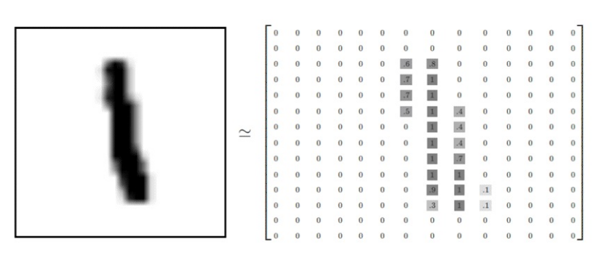
The picture below shows how to represent the picture of the left in a matrix format. Note that, the original matrix has been standardized to be between 0 and 1.
For darker color, the value in the matrix is about 0.9 while white pixels have a value of 0.

Slide 12
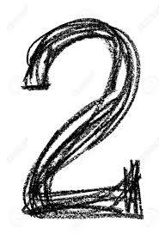
CNN Architecture.
FC_4
Fully Connected
Neural Network
FC_3
Fully Connected
ReLU Activation
Max-pooling
(2x2)
0
Conv_2
Convolution
(5x5)
Max-pooling
(2x2)
1
Conv_1
Convolution
(5x5)
2
.
.
.
.
9
Output
Input
28x28x1
n1 channels
(24 x 24 x n1)
n1 channels
(12 x 12 x n1)
n2 channels
(8 x 8 x n2)
Flattened
n2 channels
(4 x 4 x n2)
n3 units

Slide 13
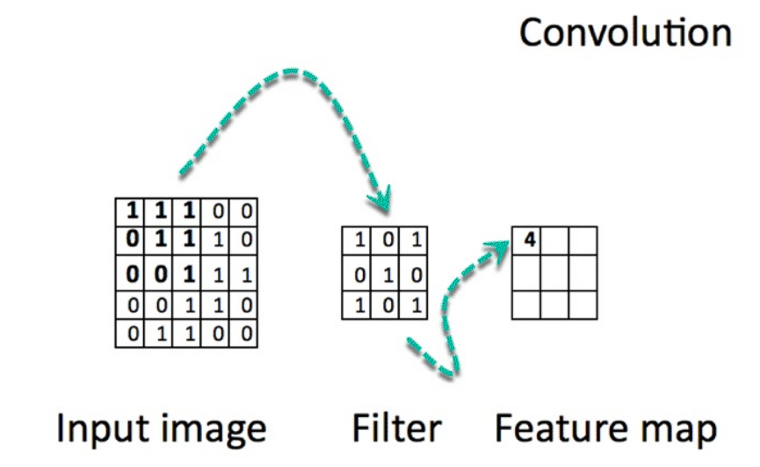
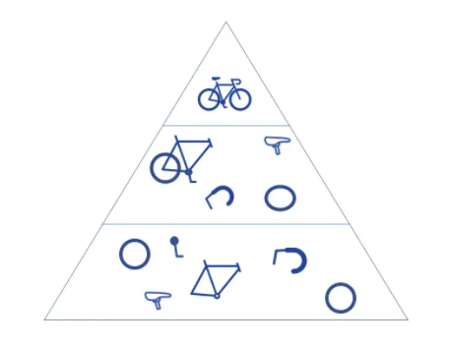
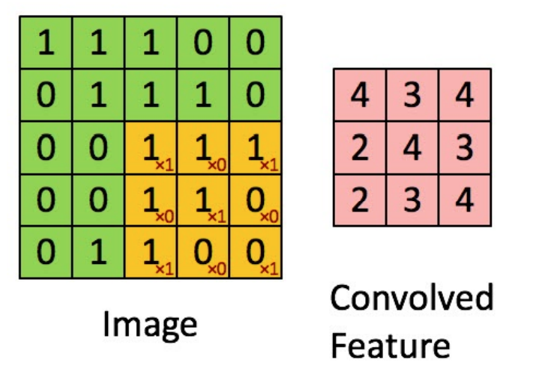

Slide 14


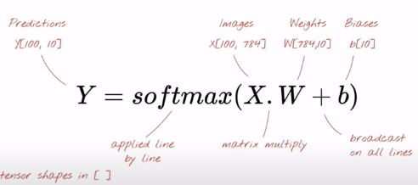
Simple Softmax Classification.

Slide 15
Simple Softmax Classification.
784 Pixels
….
.
.
.
.
Input
28x28x1
.
.
.
.
0
1
2
3
9

Slide 16
Implementation of NN.
Feed Forward
Set of Input features and random weights
Weights will be optimized by back propagation
Back Propagation.
Calculating error between predicted output and target output and use Gradient descent method to update weights
Gradient Descent.
Machine Learning algorithm
It operates iteratively to find the optimal values for its parameters. user-defined learning rate, and initial parameter values

Slide 17
Vanishing & Exploding Gradient.
It is very common problem in every Neural Network, which is associated with Backpropagation.
Weights of network are updated through backpropagation by finding gradients.
When the number of hidden layer is high, then the gradient vanishes or explodes as it propagates backward. It leads instability in network, unable to learn from training
The explosion occurs through exponential growth by repeatedly multiplying gradients through the network layers that have values larger than 1.0
It can be fixed by redesigning the network, using Long Short Term Memory networks, Gradient clipping, etc.

